Slide 1
Discourse Analysis of Guinea-Bissau Creole Texts
David Frank
SIL International

Slide 2
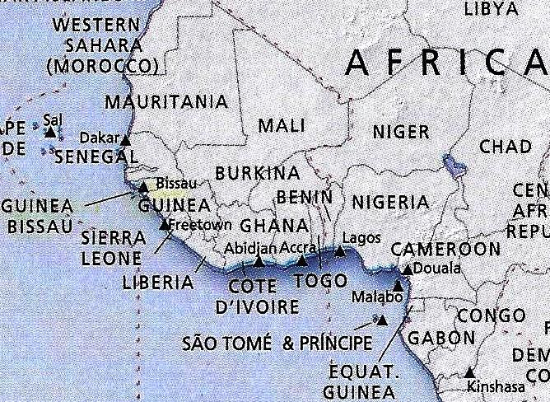

Slide 4
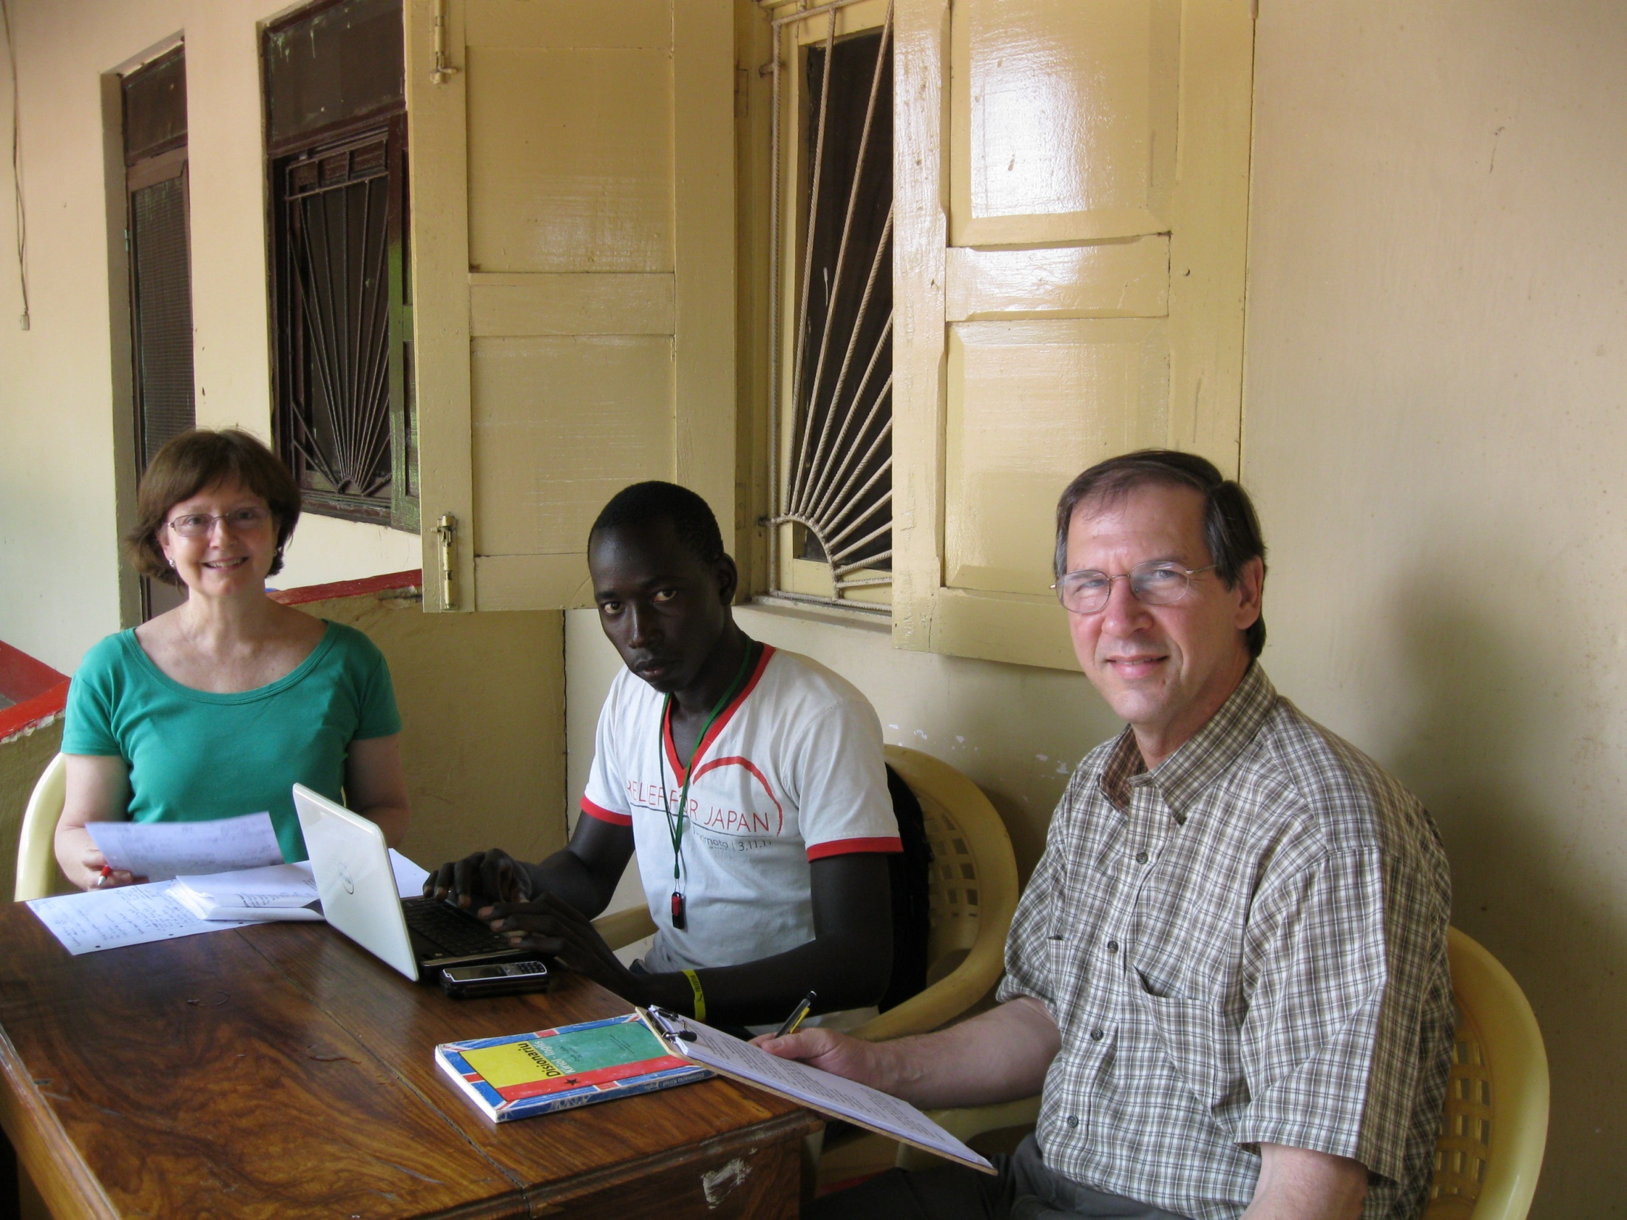

Slide 5
What to look for in discourse?
Structure
Cohesion, including repetition, participant reference
Also, distribution of verb phrase forms, and other construction types

Slide 6
In terms of structure…
text = sentence + sentence + sentence…
sentence = (sentence margin) + sentence nucleus
sentence nucleus = (dependent clause) + independent clause + (dependent clause)
clause = subject + predicate
dependent clause = subordinating conjunction + clause

Slide 7
nghaye Joel Malam Tchuda
Na bin fala di kultura di Balanta, nghaye.
Nghaye na kultura di Balanta i un etapa di vida ki ora ku bu ciga kil nivel, enton, bo ta fasi es us comadu nghaye. I ora ku bu na fasi es, bu ta muda di nomi, ker ser, nomi ku bu pape ku bu mame comau ba, bu ta muda del, i enton, bu ta pasa tene utru nomi. Enton, i es grupu di jinti e ta yanda en konjuntu, e ta yanda pa kasadias, i elis e ta panta mininus ku ta misa na kama. Tambi e ta toma kusas di jinti na kasa e bai bindi pa utru kasa, suma kil ku e toma na bu kasa, e na bindil na kasa di Elisa, kusa ke toma na kasa di David, e na bindil na kasa di Elisa. I elis tambi dipus di e na kaba es kultura nghaye, e ta organisa un dia, un festival garandi, nde ke na kumbida tudu jinti.
No ta coma es festival kusunde. E ta organisa un baju nde ke na baja pa mostra jinti se talentu ke ku e sibi fasi.
Es i pormenores ou es i un bokandiñu askerka di nghaye.
I am coming to talk about [something in the] Balanta culture [called] nghaye.
Nghaye in the Balanta culture is a stage of life that when you arrive at that level, so, you do this ethnic tradition called nghaye. And when you do this, you change [your] name, that is to say, the name that your father and your mother called you, you change it, and so, you come to have a different name. So, this group of people, they walk together, they walk from house to house, and they scare children who wet their beds, also they take things from people’s houses, they go and sell to another house, for example, what they take from your house, they sell it to Liza’s house, those they took from David’s house, they sell it at Liza’s house. And they also, after they finish this nghaye culture, they organize a day, a big fesival where they invite everybody.
We call this festival kusunde. They organize a dance where they dance to show people what they know [how to] do.
These are some details or this is a little bit concerning nghaye.

Slide 8
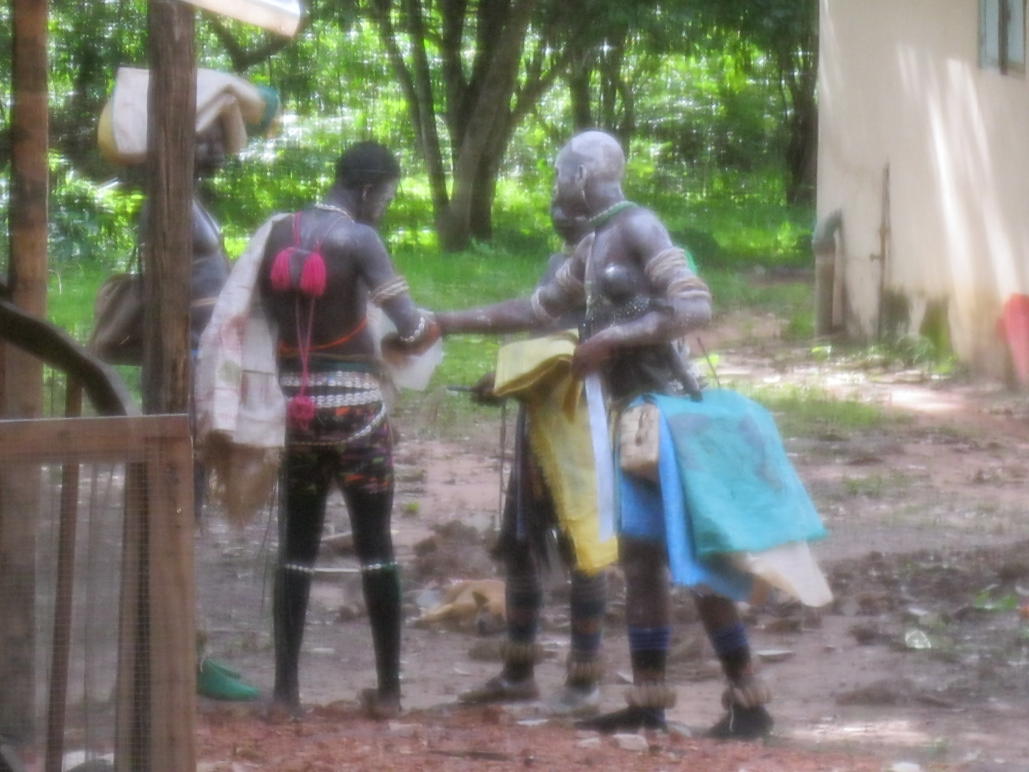

Slide 9
nghaye Joel Malam Tchuda
Na bin fala di kultura di Balanta, nghaye.
Nghaye na kultura di Balanta i un etapa di vida ki ora ku bu ciga kil nivel, enton, bo ta fasi es us comadu nghaye. I ora ku bu na fasi es, bu ta muda di nomi, ker ser, nomi ku bu pape ku bu mame comau ba, bu ta muda del, i enton, bu ta pasa tene utru nomi. Enton, i es grupu di jinti e ta yanda en konjuntu, e ta yanda pa kasadias, i elis e ta panta mininus ku ta misa na kama. Tambi e ta toma kusas di jinti na kasa e bai bindi pa utru kasa, suma kil ku e toma na bu kasa, e na bindil na kasa di Elisa, kusa ke toma na kasa di David, e na bindil na kasa di Elisa. I elis tambi dipus di e na kaba es kultura nghaye, e ta organisa un dia, un festival garandi, nde ke na kumbida tudu jinti.
No ta coma es festival kusunde. E ta organisa un baju nde ke na baja pa mostra jinti se talentu ke ku e sibi fasi.
Es i pormenores ou es i un bokandiñu askerka di nghaye.
I am coming to talk about [something in the] Balanta culture [called] nghaye.
Nghaye in the Balanta culture is a stage of life that when you arrive at that level, so, you do this ethnic tradition called nghaye. And when you do this, you change [your] name, that is to say, the name that your father and your mother called you, you change it, and so, you come to have a different name. So, this group of people, they walk together, they walk from house to house, and they scare children who wet their beds, also they take things from people’s houses, they go and sell to another house, for example, what they take from your house, they sell it to Liza’s house, those they took from David’s house, they sell it at Liza’s house. And they also, after they finish this nghaye culture, they organize a day, a big fesival where they invite everybody.
We call this festival kusunde. They organize a dance where they dance to show people what they know [how to] do.
These are some details or this is a little bit concerning nghaye.

Slide 10
lobu ku lebre Joel Malam Tchuda
Na bin konta storia di lobu ku lebre. Suma ku no sibi na storia lobu ku lebre, elis i dus amigus.
Un dia, lebre fala ku lobu, “N misti pa bu kumpañan kau di ña tio, mas n misti dau alguns splikason, ker di ser, ora ku bu na bai ku algin pa kau ki ka kunsi, bu ta mostral alguns normas o regras ku ten la pa ka i bin yara.” Enton lebre fala pa lobu, “Si no ciga kau di ña tiu, sertamenti ki kau di se tio elis tudu porki elis un bias, dus amigo ja si tio nta sedu bu tio, oca ke ciga ou antis di e ciga na kamiño i kontal kuma kau di ña tio, si bu oca mininos ou algin garandi i pega faka i pui mininos pa senka galiña pa mata, sibi kuma kila la e misti fasiu mal, ma ora ku bu oca e na kuri ena serka galiño, ke ku bu ten ku fasi, bu tene ku lanta na segredu pa kur, ami tanbi, pabia si no sai juntu e na nota, ami na i entra pa dentru nkanba janela, enton bu pudi kuri suma ka na bu no bai misa but a pasa, enton asin ki a kontisi, oca ke ciga onde se tio, tio sinti kontenti, pabia su briño bin ainda i mostral if ala es i ña kolegu lobu. “I falal muito ben,” tio cama napidu si fiju mas garandi i falal” paña ki galiña bu mata pa i pudi fasidu bon bianda pa ña subriños ku bin jubin, oca mininos na serka galiña, lubu fika muitu npasmadu, stab a muitu aturmentadu, logu kil ora lebe finji lanta i entra dentru suma in a bai bibi yagu, mas ntenson pa lobu suma if ala ba ja ki la kuma, i na entra pa kanba janela, lobu ka pera nada i lanta tanbi suma kin ku na bai misa, dipus i ku ri bai, i fala, “I tene sorti…Aos ku n muito tudu, tudu, si lebre ka visan ba, n muri ba aos, kil ora lubu kuri. Oca ku lebre sai di dentro i fala.” Nta nunde ña amigu lobu,” e falal no ka ocal, no pensa kuma i bai misa, ma te gos i ka bin, di la lebre fika i kume karne di ki galiña ke prupara pa elis, tok i kaba, oca ki sai di la, i kontra ku lobu, lubu pui ba mon na boka, i fala lebre aos ku nten sorti tudu, si bu ka visan ba ami, n muri,” ki la fal? Bu oja ki ku n tao kontau, ami senpri i bu amigu.
Ma na bardadi es i ka diritu ke ku lebre fasi. Manga di bias i ta kontisi na no vida. No misti sedu amigu di algin mas no ta nganal. Es i ka diritu. No tene ku sedu fiel a no amigu.

Slide 11
kabra ku sancu Joel Malam Tchuda
Na bin konta storia di kabra ku sancu.
Un dia kabra disidi na kasa, i fala i na bai pa matu, ma i na pidi sancu si kila pudiba sinal na manera di sibi na pe di arvuri, pabia manga di bias i ten fomi tempo di seku ma i ka tene manera di sibi pe di arvuri.
Oca ku i ciga na matu i oja sancu. Kabra falal, “Sancu n mistiba pa bu sinan na manera di sibi pe arvuri.” Ma sancu suma i sibi kuma kabra mora na kasa ku kacur i el ku kacur gora e ka ta oja, i fasi kabra un purgunta, “Nta si n sinau sibi bu ka na bai mostra kacur na manera di sibi tambi?” Kabra falal, “Sin, pabia nin ami tambi n ka ta kombersa ku el.” Enton sancu eraba muitu spertu. I falal, “Bin na sinau na manera di sibi na bagabaga. Ora ku u pudi, utru semana na mostrau manera di sibi na pe di arvuri,” pabia i ka teneba fiansa, pabia kabra eraba limaria ku ta papia ciu. I ntindi ben kuma kabra dibi di bai konta kacur. Asin ku i fasi ku kabra.
Oca ku kabra sibi ja sibi i riba pa kasa ku kontentamentu, i fala, “O kacur bu sibi ke ku na pasa? Ami gos n ta sibi na bagabaga, sancu sinan sibi bagabaga utru semana na pudi sibi pe di arvuri.” Kacur falal, “Mostran tambi manera ki sinau.” I fala, “Sta bon, no ka na bai pa matu juntu pabia si sancu ojau so, i na kuri, ma na ba ta sinau na kasa.” I kumsa logu na sina kacur tambi sibi na bagabaga, i ka nota kuma sancu sta ao ladu i na oja elis.
Dia siginti sol mansi i riba pa matu, sancu falal, “Kuma, abo i ka bon amigu, bu ka ta guarda sigridu, bu fala kuma pa nsinau sibi arvuri, n fasiu purgunta si kontra bu ka na bin sina kacur. Bu fala bu ka na sinal di nin un manera, ma bu fasi akontrariu pabia aonti n ojau bu sina kacur tok i na sibi pudi sibi ja na bagabaga. Pa kila n ka na sinau, abo i ka bon amigu, bu ka ta guarda sigridu.”
Es i lison di moral pa nos pekaduris, ora ku no ten amigu no ten ku sibi guarda sigridu. Pabia si no na papia ciu no ka na guarda sigridu no ka na ten amigu.

Slide 12
manera di labura aruz Joel Malam Tchuda
Gosi no na bin fala di kultura di arus na Guine-Bissau.
Na Guine-Bissau, suma ku no sibi, i tera di camponês, no ta fala tera di labraduris.
Arus na Guine i di produtu ku mas ta labradu pa camponês, i es arus si proseso i un bokadiñu kumpridu.
Purmeru no ta waga arus na tera, i ora ku no waga es arus, i ta fika la, i ta fasi un mis, i ta kirsi, i ta ciga un altura, no ta rinkal, no ta lebal pa bulaña, i ta fika la tok i ta kusidu.
Ma antis di i kusidu kacus ta ria la pa pudi danal, no ta manda mininus pa bai la pa bai bisial.
I es mininus e ta bisial tok i ta ciga dia di i kebradu.
Ora ki na kebradu, omis ta ria na bulaña pa kebral, mas minjer ta bin ku balai pa tiral la na bulaña, pa lebal pa kau seku.
Na tera la na ki kau seku, i ta yabridu un kampu, i nde ki ta juntadu tudu, i un dia omis ta bin e ta suta es arus, i minjeris ta fekil pa separa bon arus ku ndaure, i ora ki es sedu, la, i ta sutadu i juntadu na un kau.
Kil bon arus i lebadu pa kasa, i la na kasa no ta pul na sakus, ou na bembas.
Di la minjeris ta kumsa na tiral ja di dentru pa pul na pilon pa pila, asin pa i torna arus limpu, pa pui na kasirola, pa kusiña, asin no ta tene arus o bianda di arus limpu.
Es i tudu kuantu a kultura di arus na Guine-Bissau.

Slide 13
montiadur di timbas Ana Indibe
I tenba un omi comadu Brinkpande ku kustuma montia timbas na koba.
Un dia, i bin sai pa bai cur ku si dus kolegas. Ma na metadi di kamiñu i bai panti na matu pa fasi nesesidadi.
Nde ki i bai kaba i oja un koba na monti di bagabaga. I pensa kuma i koba di timba ku sta la. Ma i bin sai, e bai pa kau di cur. Ma oca e bin na riba, e bin tok ke ciga na mesmu kau.
I torna panti mas ki mesmu kau. I ciga son. I tira kamisa kinti-kinti. I mara si lope tesu. Suma di kustumi, i miti mon na koba pa paña timba. I pensa kila ku sta la.
Ma oca ki miti mon, i sinti un kusa diferenti ku murdi si mon. I ka pudi sai. Anta di la, i kumsa junda mon pa tira ku tudu forsa tok i kalura. Lope tudu dismanca ku el ma i ka pudiba tiral. Tambi i medi pupa risu pabia i ka kontaba si kolegas ke ki na bai fasi na matu. Ma suma kilas oja i tarda dimas, e panti pa bai sibi ke ki na kontisi ku el.
Oca e ciga, e oja Brinkpande kalura ku si mon dentru di koba. E kumsa na jundal tok e tiral di koba. Mon sai juntu ku kabesa di iran segu. Suma kila murdil risu, gosi e sapa kabesa di iran segu. Kila fika na mon di omi.
Kil ora i kumsa na kuri ku kil kabesa na si mon. Jintis ojal i na kuri. E fika e na punta si kolegas: “Ke ku tene Brinkpande ku pui i na kuri?” Kilas fala elis: “Kabesa di iran segu ki tene na mon.”
Disna di la pa dianti, ki omi para bai montia timbas.
Pabia di kila i bon pa ka miti mon na kau ku bu ka na oja.

Slide 14
montiadur ku pasa kasabi Filipe Alberto
Un omi ciga di bai montia gazelas na matu, i yanda matu disna di parmaña te di noti i ka oja nada, i disidi riba pa tabanka.
Na kamiñu pa tabanka i oja un gazela i miral ku arma i fugia.
Oca ki fugia, si propi baka kortela dianti di bala.
Gosi omi ka tene utru manera di fasi i pega na grita i na fala si baka:
“Kortela rapidu! Kortela rapidu pa ka bala pañau!”
Ma nin ku kila baka ka obi tok bala pañal i kai i muri.
Omi sinta na con i pega kabesa ku dus mon i kumsa na cora.
Dipus ki kaba cora i lanta i toma si arma i bai pa tabanka.
Dipus ki ciga kasa si fijus puntal:
“Papa, bu ka mata nada aos?”
I fala elis:
“Disna ku n lanta n kumsa na montia nunka n pasa kasabi, ma aos n pasa un garandi kasabi, n fugia un gazela ña uniku baka ku n sobraba ja ku el kortela dianti di bala, bala pañal i kai i muri.”
Omi paña raiba i nega kumel.
I konta si viziñus e bai buskal e bin folal e kume.

Slide 15
fiu maña Blulu Bitam
Na dia seti di Juñu di 1998, un grupu di tropas ku staba ku Ansumane Mane kria revolta kontra Presidenti Ninu Vieira pabia di buska lugar pa minjor manda. Ansumane mobiliza grupu di diskontentis ku abandunadu tambi pa Presidenti Ninu Vieira.
Dia seti di Juñu seis ora tirus kumsa. Balentis pega lutu, Bissau kumsa na cora, armas na papia kada bias mas altu.
Radius kumsa na da informason, i na fala: “Bo sai di Bissau! Bo sai! Ninu Vieira ka bali!” I pasa un dia, tropas Senegaleses ciga con di Guine-Bissau pa juda Presidenti Ninu Vieira. Pa kila, manga di antigus kombatenti bai junta ku Ansumane kontra Ninu Vieira. Kada bias ku armas na fala mas altu, pupulason mas na abanduna se kasas. Tudu armas belikus ku ten na Guine usadu ne gera di seti di Juñu.
Ladrons toma konta di sidadi, e na furta kusas di balur di jinti. Bissau fika kalmu, fumu ku baruju di bumbas di tudu ladu. Purkus ku jukudes na kume karni di jintis ku matadu, kacuris tambi ka fika tras di sena. Presidenti Ninu manda pidi reforsu di Senegal ku Fransa. Mesmu asin, i ka safa nada, pabia di spiriensia ku tropas di Guine-Bissau tene.
E gera ka ten resultadu, pabia i son fijus di Guine ku na mata nutru. I muri minjeris, kriansas, militaris, ku utrus jintis sin sintidu di nada. Bispu katoliku, igreza evangeliku, musulmamus ku Sosiedadi Sivil bai nogosia ku elis manada ka bai. Armas mas na kanta na rebenta predius di kapital.
Guine pirdi ku e gera di seti di Juñu, gosi ku no mas koitadi di ki purmeru.

Slide 28
Summary Observations
In General:
Theme-rheme presentation of information.
Beginning and end of text is the framing, using stative verbs.
Participants are referred to as NP not as subject; subsequently as subject pronoun.
Sentence connectives mainly denote new stages in development; otherwise implicit.
Sentential connective Ma marks a turning point.

Slide 29
Summary Observations
In Narratives:
Within the frame that comes at the beginning and end, the backbone of the narrative uses nonstative (active) verbs unmarked for tense-mood-aspect.
Other verb phrase configurations would likely be in dependent/subordinate clauses, in reported speech, or in amplification-type material woven into the narrative.

Slide 30
Summary Observations
In Procedural or Expository Texts:
Verbs on the backbone of the text marked with ta.
Purmeru might mark first step, ma (‘but’) might mark complications, asin (‘thus’) might mark conclusion; otherwise sentence relations are left implicit or denoted simply by i (‘and’).

Slide 31
